Slide 1
EEP 153 PROJ 3
UGANDA FOOD AND CONSUMER DEMAND DURING WET AND DRY YEARS
Carmen Vega, Emily Wu, Mario Zhao, Jing Huang, Rania Nasser

Slide 2
GOALS:
ANALYSING FOOD AND CONSUMER DEMAND IN UGANDA DURING WET AND DRY YEARS
1.What are the trends in food prices and expenditures in Uganda in different years, especially in dry and rainy years? 2.How does the consumption structure of different food categories evolve over time or climate conditions? 3.Can household nutrients (energy, protein, trace elements, etc.) be met? Does the dry and wet year have a significant impact on it?
Mary Paley

Slide 3
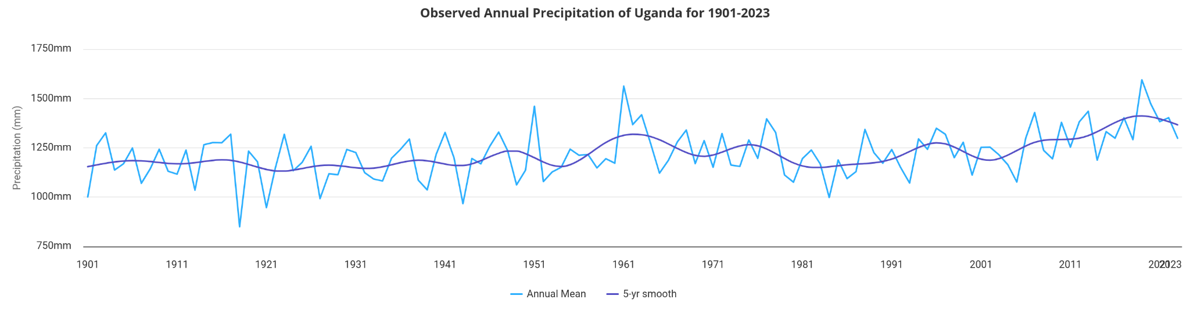
WEATHER PATTERNS IN UGANDA
Mary Paley
General increase from 2005-2020…
could relate this to nutrition data in other ways?

Slide 4
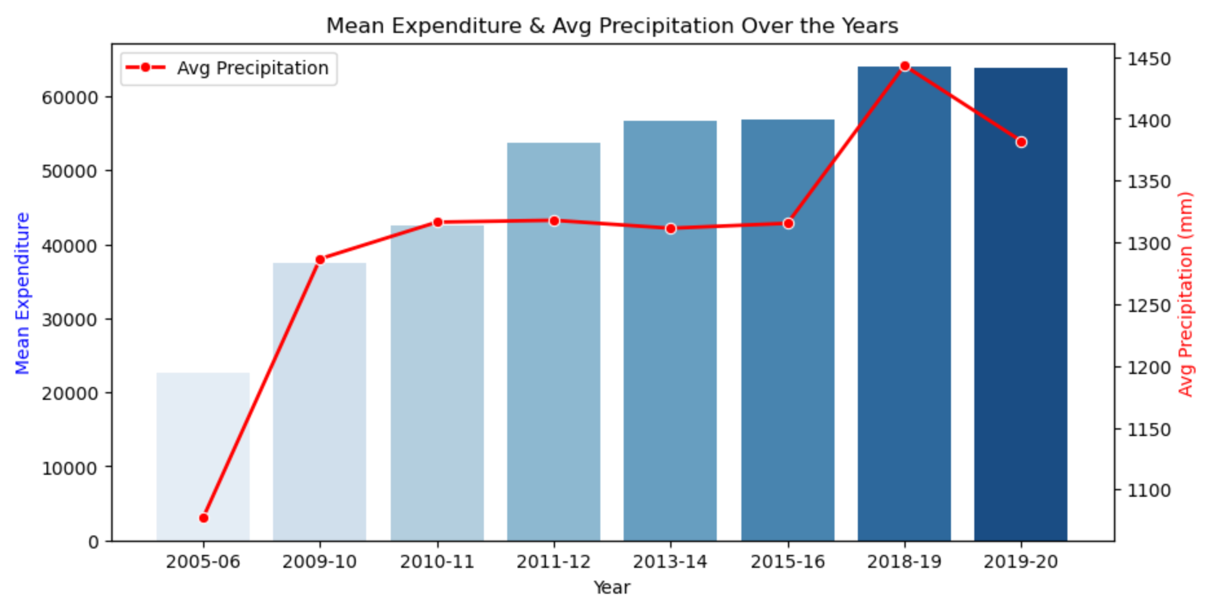
Lit Visual imo

Slide 5
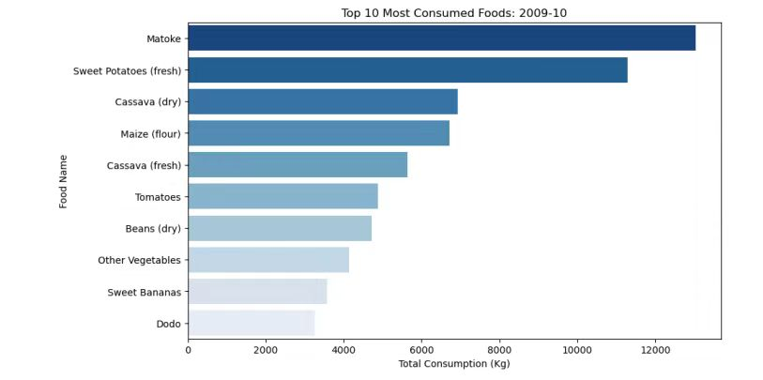
A WET YEAR IN UGANDA
Mary Paley

Slide 6
A DRY YEAR IN UGANDA
Mary Paley
IMPACT ON AGRICULTURE
● UGX 911.8 B ($250K)IN FOOD CROP LOSSES
● UGX 1.1 T($300K) IN LIVESTOCK LOSSES
WIDER CONSEQUENCES
US$ 1.2B TOTAL LOSSES (7.5% OF GDP)
FOOD PRICES SURGE & ENERGY SHORTAGE

Slide 7
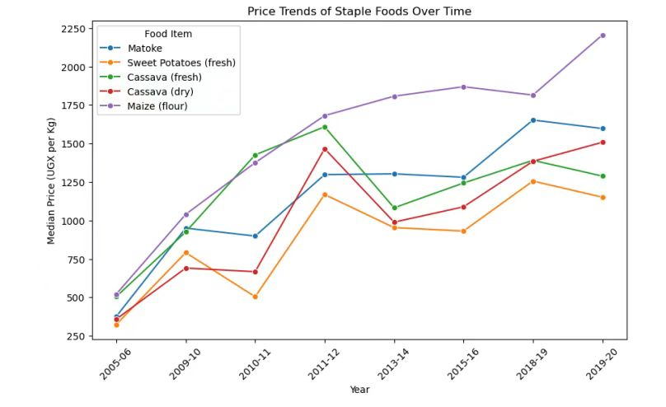
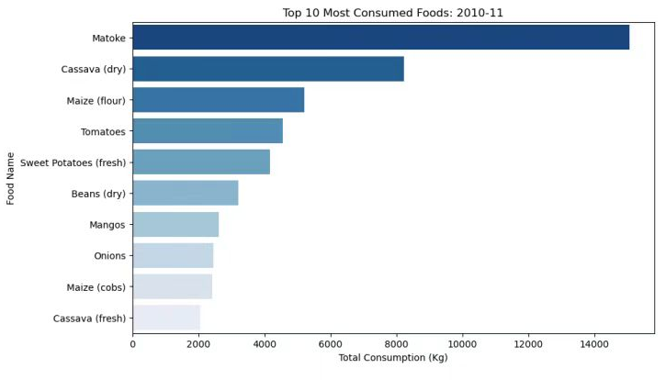
FOOD DEMAND IN UGANDA
Mary Paley

Slide 8
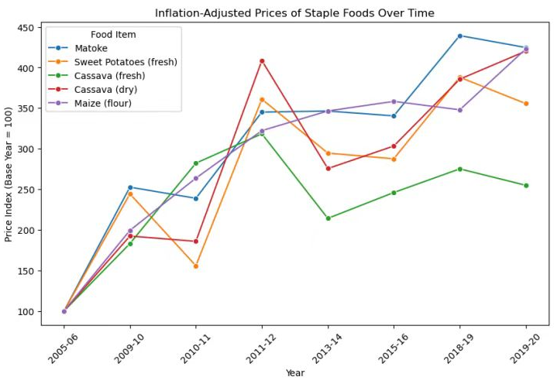
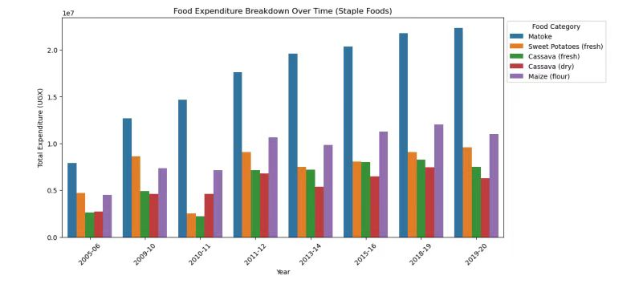
over time

Slide 9
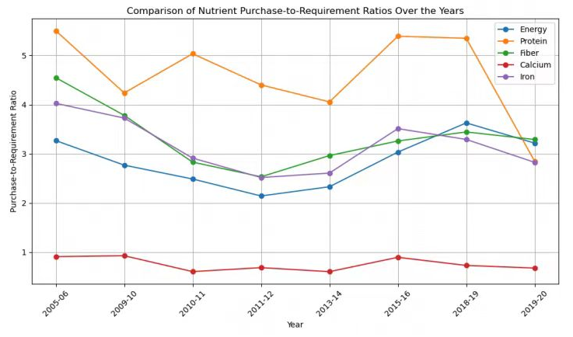
FOOD

Slide 10
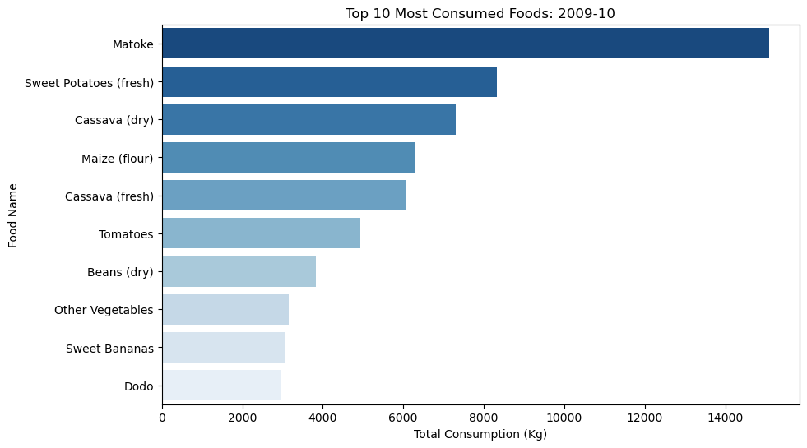
TOP 10 MOST CONSUMED FOODS
2009 - 2010
SKATE CLUB

Slide 11
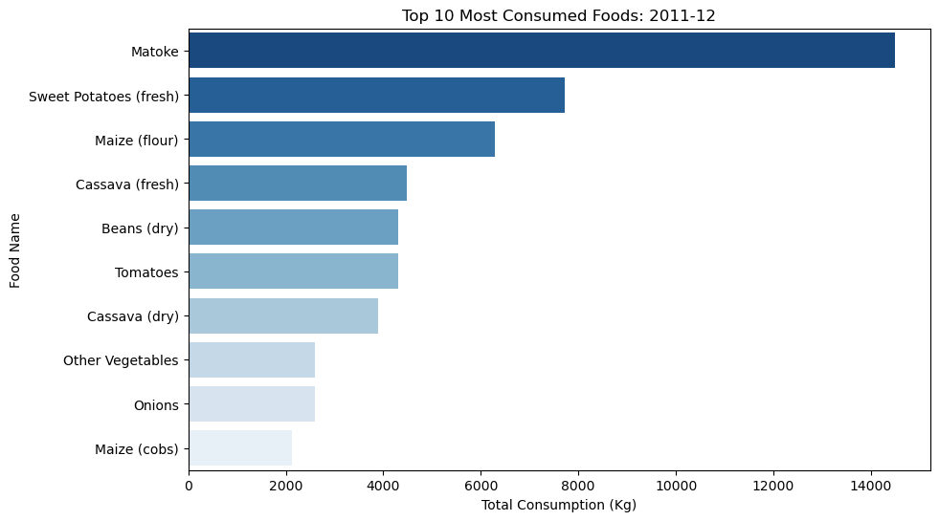
TOP 10 MOST CONSUMED FOODS
2011 - 2012
SKATE CLUB

Slide 12
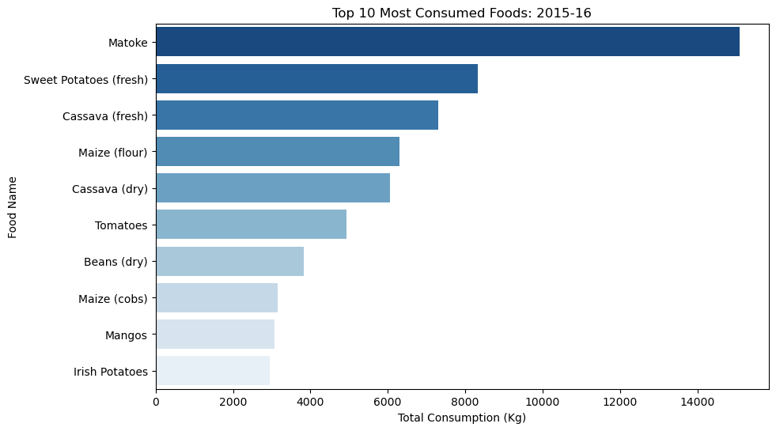
TOP 10 MOST CONSUMED FOODS
2015 - 2016

Slide 13
Q:
A:
SKATE CLUB
What impact does the weather in Uganda, Africa have on crops?
1.Adequate precipitation benefits growth;
2.Temperatures are suitable for year-round cultivation;
3.Uneven rainfall causes droughts and floods.

Slide 14





THANK
YOU
SKATE CLUB

Slide 15





JOIN
US

